Slide 1

This course was developed as a part of the VLIR-UOS Cross-Cutting projects:
Statistics: 2011-2016, 2017.
Statistics: 2017.
Statistics for development : 2018-2022.

Slide 2





Basic concepts in statistical modeling using R: A Simple Logistic Regression
The >eR-Biostat initiative
Making R based education materials in statistics accessible for all
Developed by
Legesse Kassa Debusho (UNISA, South Africa), Ziv Shkedy (Hasselt University, Belgium)
and
Tadele Worku Mengesha (Gondar University), Abdisa Gurmessa (Jimma University)
https://erbiostat.wixsite.com/erbiostat
ER-BioStat
https://github.com/eR-Biostat
Email: erbiostat@gmail.com
@erbiostat

Slide 3
Contents
Logistic regression:
  Notation and model formulation.
    Zero/one data.
    Data in frequency tables.
  Examples.
  The glm() function in R.
  Fitting logistic regression models using the glm() function in R: 5 examples.

Slide 4

Recommended reading
In this part of the course, we cover mainly Section 9.5.
The examples that are used for illustration are not the same as the examples in the book.
The book is available for free online:
https://www.openintro.org/book/biostat/
Section 9.5: introduction to logistic regression

Slide 5
Introduction

Slide 6
Introduction
In health, education, medical and social sciences, we frequently deal with dichotomous or binary outcomes.
For example, we may have data on presence (Yes) or absence (No) of an event.
For example; presence or absence of :
    Anaemia.
    Ebola.
    Diabetes.

Slide 7
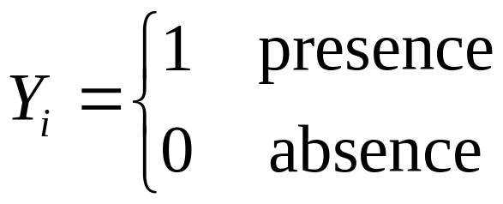
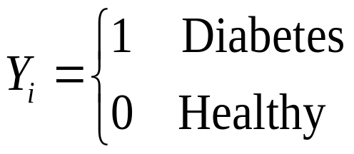
The response variabel
A binary variable:
An example:

Slide 8
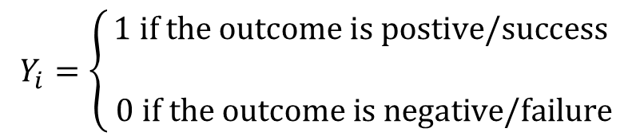
Bernoulli random variables
Let Y₁,Y₂,…,Y_{n} represent a sample of Bernoulli random variables from n trials:

Slide 9
The predictor(s)
Our aim is to model the dependence of the probability of success upon known predictors (=explanatory variable(s)).

Slide 10
Logistic regression model
Our aim is to model the dependence of the probability of success on known predictors.
Example:
The model that we use to model the dependence between diabetes and the predictors is a logistic regression model.

Slide 11
Model formulation

Slide 12


Model formulation for zero/one (binary data)
The distribution of Y_{i}
Our aim is to model the dependency of the response on the predictor, i.e., to estimate the unknown parameters α and β
Dependency of Y_{i} on the predictor X_{i}
The probability of success.
The model consists of three components: the distribution of Y, the dependency of predictor(s) and the structure of the probability of success.

Slide 13
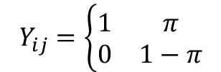
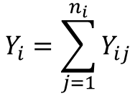
Binary data in frequency tables
Predictor | Response | Sample size
X₁ | Y₁ | n₁
X₂ | Y₂ | n₂
. | . | .
. | . | .
X_{I} | Y_{I} | n_{I}
For each category X_{i}, there are n_{i} observations, each observation if a binary indicator:
The response Y_{i} is the sum of all 1s in the category:
A frequency table with I categories.

Slide 14
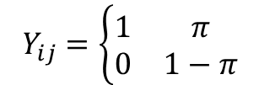
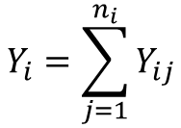


Model formulation for data in frequency tables
When data are given in frequency tables, there are n_{i} observations per category in the table.
Y_{i} is the number of 1s in the category.
The distribution of Y_{i}

Slide 15
Examples & notaions

Slide 16
Example 1: Smoked mice
In order to investigate the influence of smoking on lung cancer a group of 55 mince were randomized into two treatment groups.
In the first group (the treated group), each mouse was closed in a chamber that was filled with the smoke of one cigarette every hour in 12 hours day.
The second group (the control group) were kept in their cambers for 12 hours with out smoke.
After one year an autopsy was carried out.
The response is the present and absent of a tumour.
The second variable in the data is the treatment group.

Slide 17
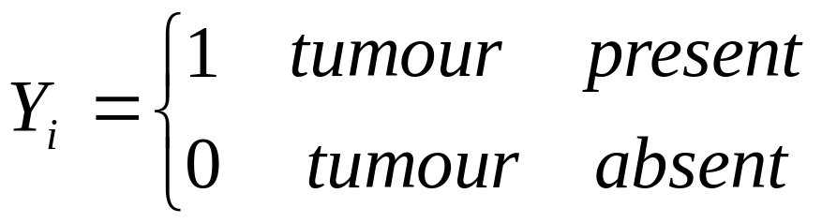
Smoked mice: the response variable
The question of primary interest is:
DOSE THE SMOKE INCREDSE THE RISK FOR CANCER ?
The response variable

Slide 18
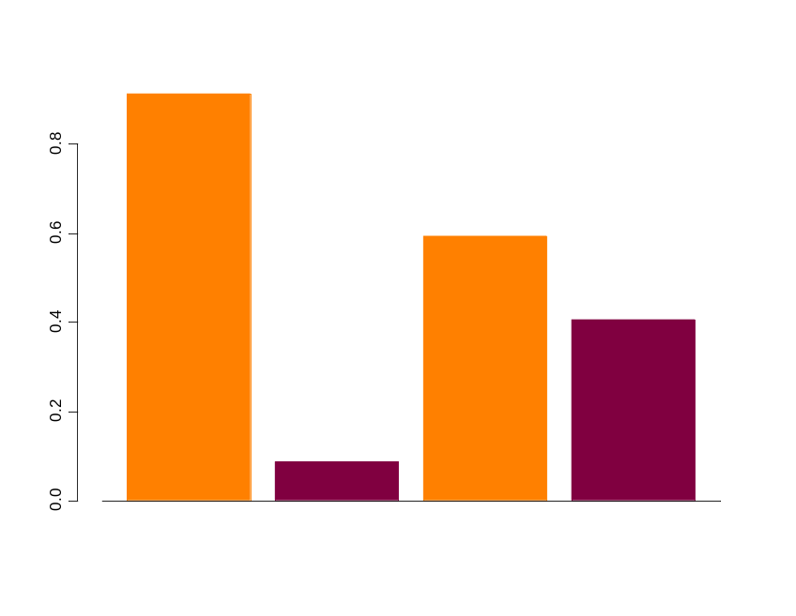
Smoked mice: the data
 | Tumour present | Tumour absent | Total
Treated | 21 | 2 | 23
Contol | 19 | 13 | 32
Total | 20 | 15 | 55
Treated
Control
present
absent
present
absent
Tumour

Slide 19
Smoked mice
 | Tumour present | Tumour absent | Total
Treated | 21 | 2 | 23
Contol | 19 | 13 | 32
Total | 20 | 15 | 55
This is an example of grouped data.
We do not have information about individuals in the sample, but only about the counts in different combinations of the experiment.
Individual data can be extracted from the table.
In terms of statistical modelling, the response is binary (tumour absent/tumour present).
The predictor, the treatment group, is also binary.
We want to model the probability to develop a tumour given the treatment group.

Slide 20

Response and predictor
Treated
Contol
In the treated group, 21/23 (91%) of the mice develop tumour. In the control group only 19/32 (59%).
The aim of the analysis is to determine if this difference is only due to chance or if the smoke increase the risk for tumour.
present
absent
present
absent
Response:
Predicator:

Slide 21
Example 2: Serological data
Antibodies produced in response to an infectious disease like malaria remain in the body after the individual has recovered from the disease.
A serological test detects the presence or absence of such antibodies.
An individual with such antibodies is called seropositive.

Slide 22

Example 2: Serological data
Sero-prevalnce data
A sample which taken at a certain time point.
The information for each individual:
Age at test.
Infected or not.
Prevalence of sero-positivity In the sample:
This is the probability to become infected before the age at test.
Susceptible
Infected
Age at test

Slide 23
Current status data: sero-negative
Age at test
Age at infection
Age
Sero-Negative: infected after the test.

Slide 24
Current status data: sero-positive
Age at infection
Age at test
Age
Sero-Positive: infected after the test.

Slide 25
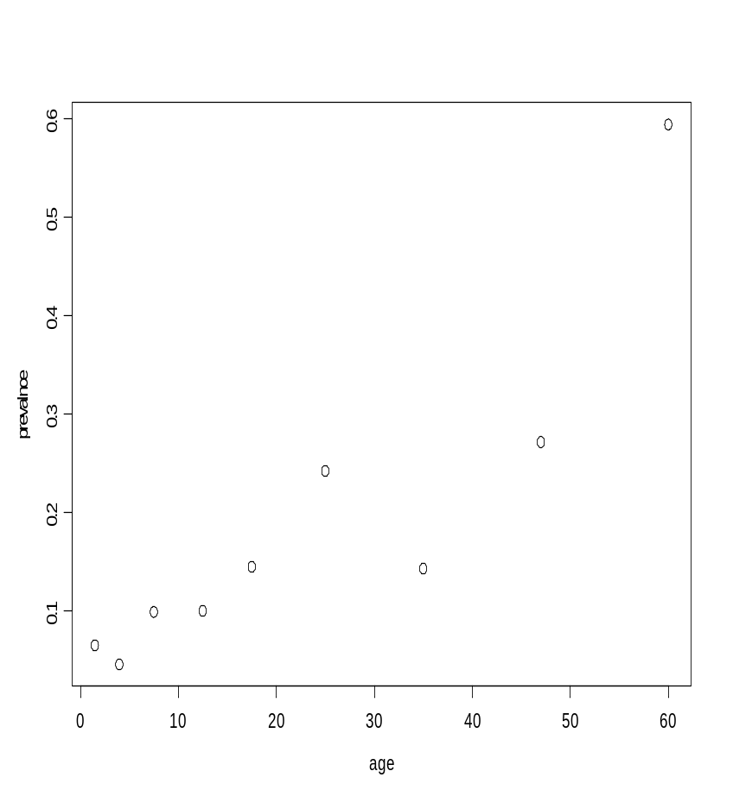
Example 2: Serological data
Malaria in Brasil
What is the relationship between infection and age ?
Age group | Mid age | Sero positive | Sample size
1 | 1.5 | 8 | 123
2 | 4.0 | 6 | 132
3 | 7.5 | 18 | 182
4 | 12.5 | 14 | 140
5 | 17.5 | 20 | 138
6 | 25.0 | 39 | 161
7 | 35.0 | 19 | 133
8 | 47.0 | 25 | 92
9 | 60.0 | 44 | 74
44/74
25/92

Slide 26
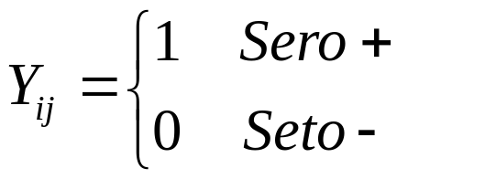
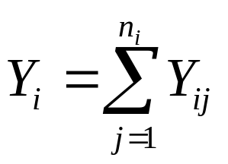

Example 2: Serological data
Age group | Mid age | Sero positive | Sample size
1 | 1.5 | 8 | 123
2 | 4.0 | 6 | 132
3 | 7.5 | 18 | 182
4 | 12.5 | 14 | 140
5 | 17.5 | 20 | 138
6 | 25.0 | 39 | 161
7 | 35.0 | 19 | 133
8 | 47.0 | 25 | 92
9 | 60.0 | 44 | 74
Response:
Number of Sero+ in age group i:
Sample size at age group i:

Slide 27


Example 2: Serological data
Response: number of infected (sero+):
Predictor: age.
We want to model the probability to be infected as a function of the age.
What is the relationship between the age and the probability to be infected ?

Slide 28
Example 3: Bioassay data
A bioassay experiment is an experiment designed to assess the potency of a compound by means of the response produced when it is administrated to a living organism.
In this example the protective effect of a particular serum (serum 32) on the bacterium associated with the occurrence of pneumonia is under investigation.
Study design:
  The experiment consist of 5 groups of 40 mice.
  Each group was injected with combination of an infecting dose of a culture of pneumococci and one of five doses of the anti pneumococcus serum.

Slide 29
Bioassay data: response and predictor
The response of the number of deaths within 7 days from injection.
The dose level is the predictor.
The question of primary interest:
What is the relationship between the injected dose and the number of deaths ?

Slide 30
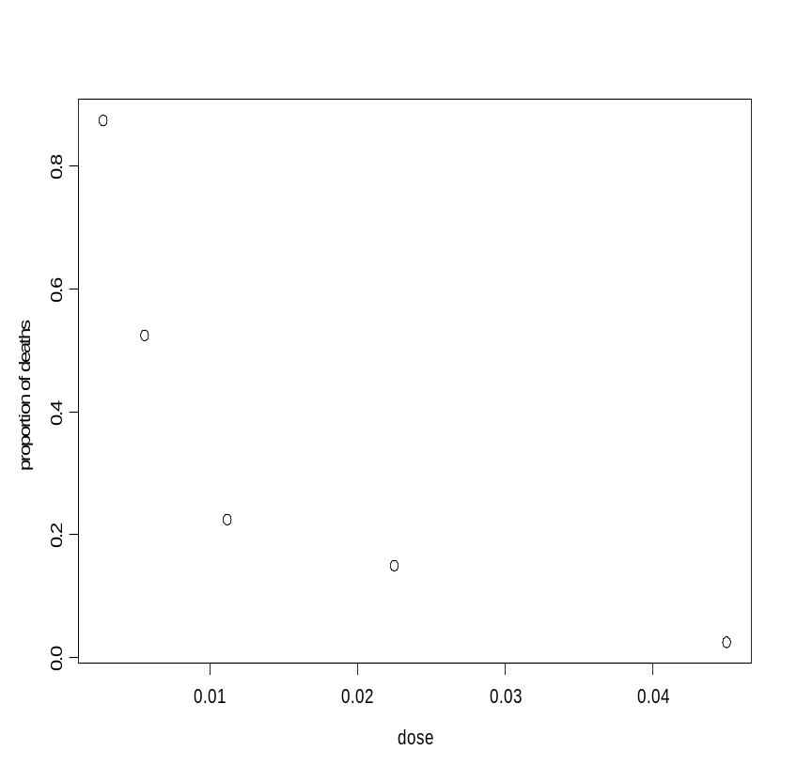


Example 3: the data
Dose of serum | Number of deaths | Sample size
0.0028 | 35 | 40
0.0056 | 21 | 40
0.0112 | 9 | 40
0.0225 | 6 | 40
0.0450 | 1 | 40

Slide 31
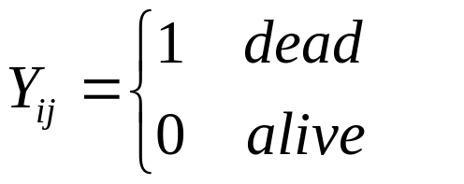

Example 3: the data
Dose of serum | Number of deaths | Sample size
0.0028 | 35 | 40
0.0056 | 21 | 40
0.0112 | 9 | 40
0.0225 | 6 | 40
0.0450 | 1 | 40
Response:
Number of deaths in dose level i:
Sample size at dose level i:
A frequency table with 5 categories.
40 subjects per category.

Slide 32

Example 3: response and predictor
Response: number of deaths at each dose level:
Predictor: dose.
The model:

Slide 33
Example 4: determination of ESR
The erythocte sedimentation rate (ESR) is the rate at which red blood cells settle out of suspension in blood plasma when measured under standard condition.
The ESR increase if the levels of certain proteins in the blood increase.
Rheumatic diseases, chronic diseases and infections increase these proteins level.
From that reason the determination of the ESR is one of the most commonly used screening tests performed on samples bloods.

Slide 34
Determination of ESR: the data
Individual Fib Glob Y
1 1 2.52 38 0
2 2 2.56 31 0
3 3 2.19 33 0
4 4 2.18 31 0
5 5 3.41 37 0
. . . . .
. . . . .
. . . . .
19 19 2.60 38 0
20 20 2.23 37 0
21 21 2.88 30 0
22 22 2.65 46 0
23 23 2.09 44 1
24 24 2.28 36 0
25 25 2.67 39 0
26 26 2.29 31 0
27 27 2.15 31 0
28 28 2.54 28 0
29 29 3.93 32 1
30 30 3.34 30 0
31 31 2.99 36 0
32 32 3.32 35 0
An example of individual data.
For each subject we have the response and the proteins level.
Main interest:
Does the Fibrinogen level (proteins in the blood) influence the ESR rate ?
Data:
  Fib: Fibrinogen level.
  Glob:
  Y: 0/1 indicator for ESR.

Slide 35
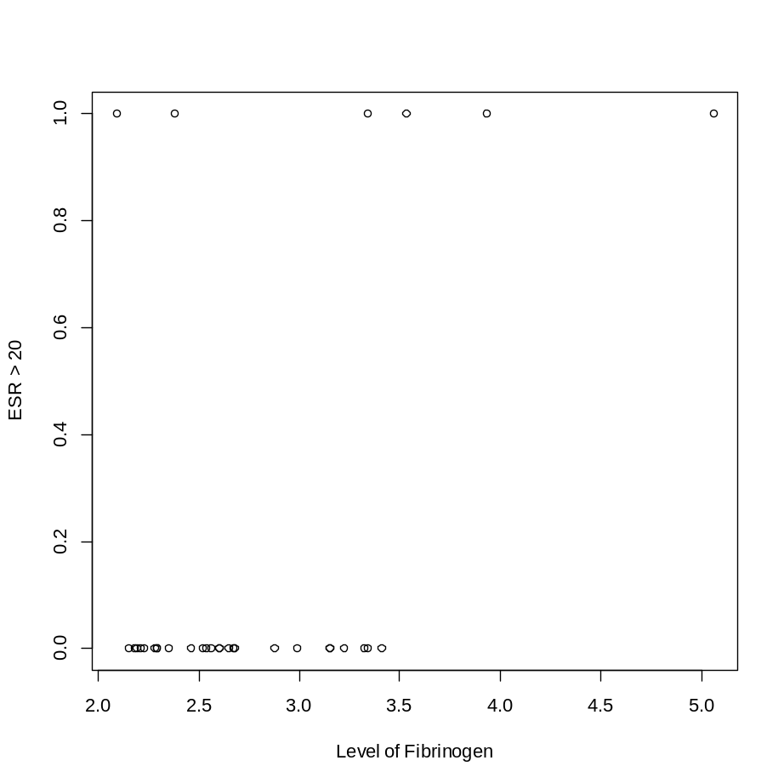
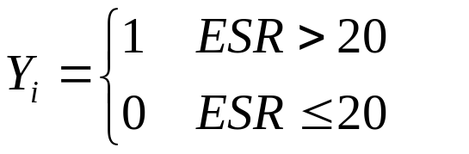
Example 4: determination of ESR
ESR > 20
Response:
Predictor: Fibrinogen level.
ESR <= 20
A model for the probability that ESR>20:

Slide 36
Example 5: Pneumoconiosis amongst coal miners
Pneumoconiosis amongst groups of coal miners with varying exposure time to coal dust.
Does exposure time increase the probability to have the disease ?
predictor

Slide 37
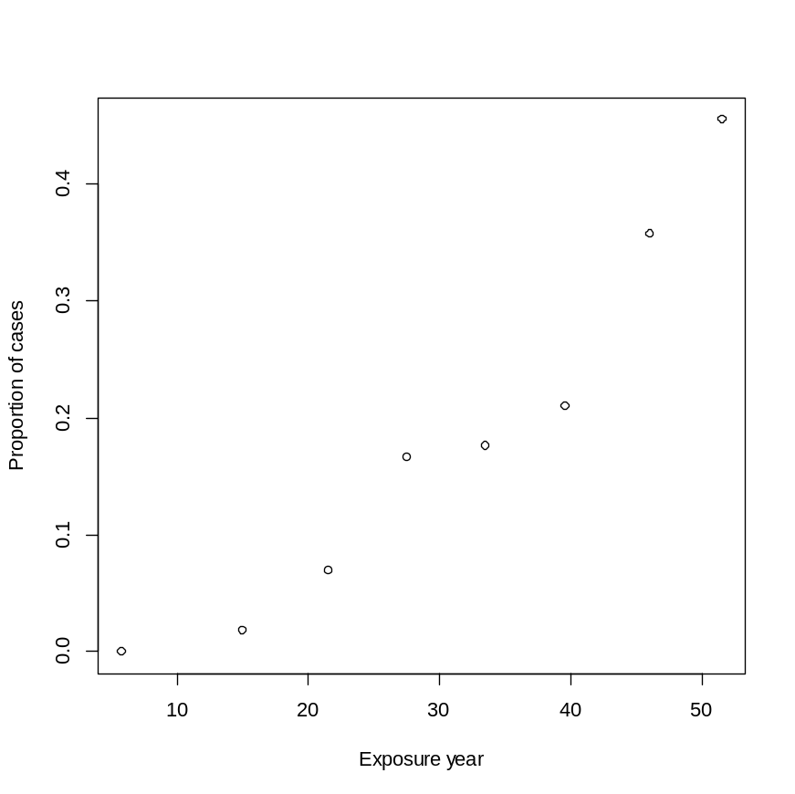
The data
Years Cases Miners
1 5.8 0 98
2 15.0 1 54
3 21.5 3 43
4 27.5 8 48
5 33.5 9 51
6 39.5 8 38
7 46.0 10 28
8 51.5 5 11
Predictor: exposure time in years.
Response: disease.
Data:
  Cases: number of miners with disease (Y_{i}).
  Miners: number of miners in the category (n_{i}).

Slide 38
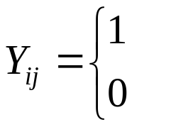

Example 5: response and predictor
Response:
Pneumoconiosis
healthy
Predictor: years of exposure to coal dust.

Slide 39
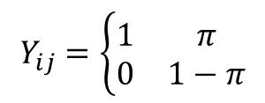
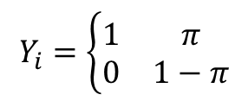
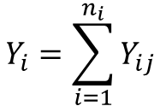


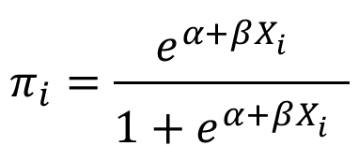
Summary: a logistic regression model
Data in table format
Zero/One data
The model for the probability (as a function of the predictor):

Slide 40
Fitting logistic regression models using the glm( ) function in R

Slide 41
The glm() Function in R
Generalized linear models can be fitted in R using the glm() function, which is similar to the lm() function for fitting linear models.
Arguments in the glm() call are as follows:
glm(formula,family,link,data,...)

Slide 42
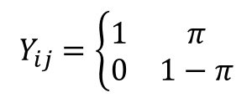
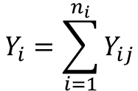

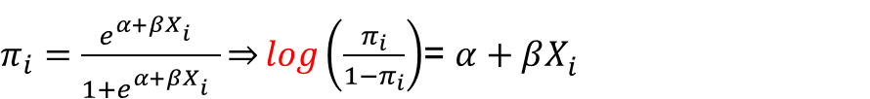
The glm() Function in R
For binary data, the general call of the glm() function has the form:
glm(formula, family=binomial(link = "logit"))
this defines a logistic regression model, i.e. a model for binary data with logit link function.
family=binomial
link = "logit"

Slide 43
The glm() Function: zero/one data.
For a zero/one data (for example the ESR data):
glm(formula,family,link,data,...)
respone~predictor 1 + predictor 2+….

Slide 44
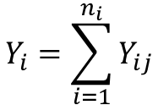

The glm() Function: grouped data
For grouped data (for example, the serological data):
glm(formula,family,link,data,...)
positive/sample size~ predictor 1 + predictor 2+....
Number of successes
Sample size in the category

Slide 45
Fitting logistic regression models using the glm( ) function in R: 5 examples

Slide 46
Example 1: Smoked mice
The question of primary interest is:
DOSE THE SMOKE INCREASE THE RISK FOR CANCER ?
The response variable
EXAMPLE 1: SMOKED MICE

Slide 47
Data structure in R
> mice <- data.frame(Treatm=c("Treated", "Control"),
+ Tumour = c(21,19), Total = c(23,32))
> attach(mice)
> mice
Treatm Tumour Total
1 Treated 21 23
2 Control 19 32
Treated
Control
present
absent
present
absent
Tumour

Slide 48
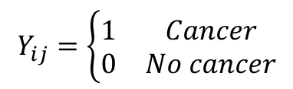
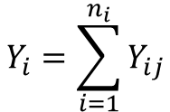

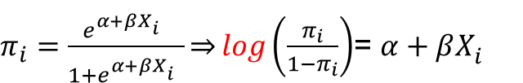
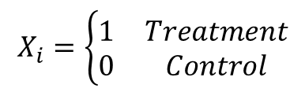
Model formulation
The individual data
 | Tumour present | Tumour absent | Total
Treated | 21 | 2 | 23
Contol | 19 | 13 | 32
Total | 20 | 15 | 55
Number of subjects with tunour
Distribution of Y
We want to model the probability to develop a tumour (i.e. cancer) given the treatment group.
Predictor: treatment group (X_{i}).
The model for the probability:
EXAMPLE 1: SMOKED MICE

Slide 49


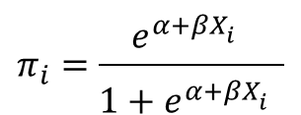
Model with Binomial family and logit link function: the glm() function
Fitting the model with the glm() function:
> fit2.mice <- glm(cbind(Tumour ,Total-Tumour)~factor(Treatm),
data = mice, family = binomial("logit"))

Slide 50
R output
> summary(fit2.mice)
Call:
glm(formula = cbind(Tumour, Total - Tumour) ~ factor(Treatm),
family = binomial("logit"), data = mice)
Deviance Residuals:
[1] 0 0
Coefficients:
Estimate Std. Error z value Pr(>|z|)
(Intercept) 0.3795 0.3599 1.054 0.2917
factor(Treatm)Treated 1.9719 0.8229 2.396 0.0166 *
---
Signif. codes: 0 ‘***’ 0.001 ‘**’ 0.01 ‘*’ 0.05 ‘.’ 0.1 ‘ ’ 1
(Dispersion parameter for binomial family taken to be 1)
Null deviance: 7.6349 on 1 degrees of freedom
Residual deviance: 0.0000 on 0 degrees of freedom
AIC: 10.421
Number of Fisher Scoring iterations: 4

Slide 51
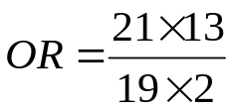
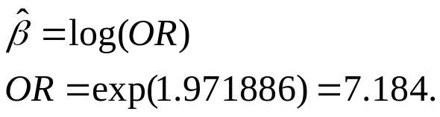
The odds ratio
 | Tumour present | Tumour absent | Total
Treated | 21 | 2 | 23
Contol | 19 | 13 | 32
Total | 20 | 15 | 55
> OR1<-(21*13)/(19*2)
> OR1
[1] 7.184211
> log(OR1)
[1] 1.971886
> summary(fit2.mice)$coeff
Estimate Std. Error z value Pr(>|z|)
(Intercept) 0.3794896 0.3599370 1.054322 0.2917354
factor(Treatm)Treated 1.9718856 0.8229056 2.396248 0.0165639

Slide 52
Example 2 (Serological data): Data structure in R
Serolog <- read.table('c:/... /Serological.txt',
+ header = TRUE, na.strings = "NA", dec = ".")
> attach(Serolog)
> print(Serolog)
Age N pos
1 1.5 123 8
2 4.0 132 6
3 7.5 182 18
4 12.5 140 14
5 17.5 138 20
6 25.0 161 39
7 35.0 133 19
8 47.0 92 25
9 60.0 74 44
EXAMPLE 2: serological data

Slide 53
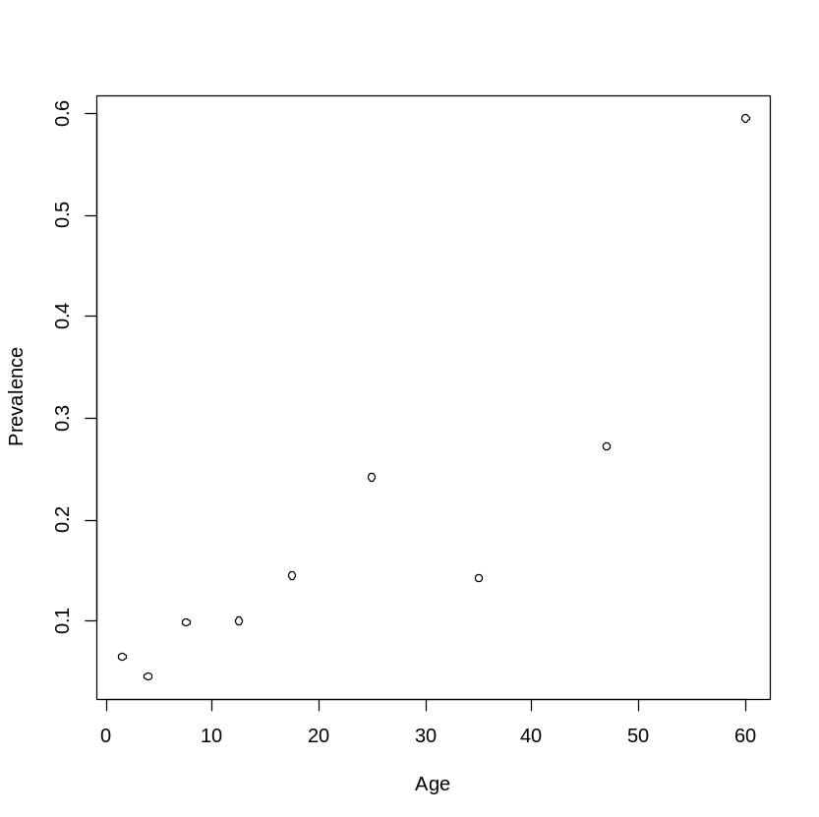
Example 2: Serological data
p <- pos/N
plot(p ~ Age, xlab = "Age", ylab = "Prevalence")

Slide 54
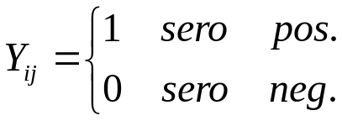


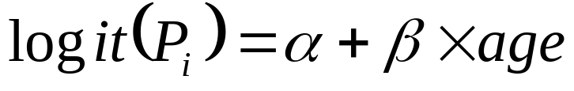
Model formulation
Mid age | Sero positive | Sample size
1.5 | 8 | 123
4.0 | 6 | 132
7.5 | 18 | 182
12.5 | 14 | 140
17.5 | 20 | 138
25.0 | 39 | 161
35.0 | 19 | 133
47.0 | 25 | 92
60.0 | 44 | 74
Number of sero-positive at each age group
n_{i}: sample size at each age group
P_{i} is the probability to be infected (the prevalence). We use logistic regression in order to model the prevalence as a function of age

Slide 55
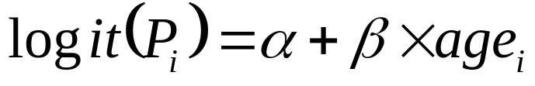
glm( ) function in R
pos/N
> fit.Sero <- glm(pos/N ~ Age, data = Serolog, family = binomial)
model pos/N=age

Slide 56


Parameters estimate
> summary(fit.Sero)
Call:
glm(formula = pos/N ~ Age, family = binomial, data = Serolog)
Deviance Residuals:
Min 1Q Median 3Q Max
-0.24363 -0.09726 0.01479 0.06756 0.19568
Coefficients:
Estimate Std. Error z value Pr(>|z|)
(Intercept) -2.79677 1.79832 -1.555 0.120
Age 0.04718 0.04668 1.011 0.312
(Dispersion parameter for binomial family taken to be 1)
Null deviance: 1.31775 on 8 degrees of freedom
Residual deviance: 0.18094 on 7 degrees of freedom
AIC: 8.0619
Number of Fisher Scoring iterations: 5

Slide 57
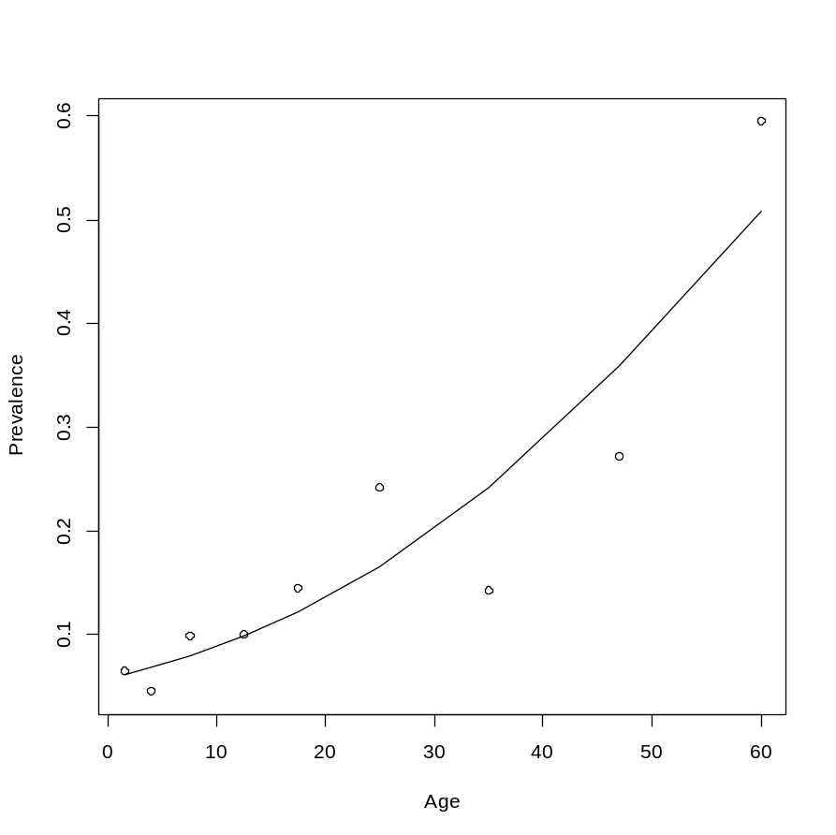

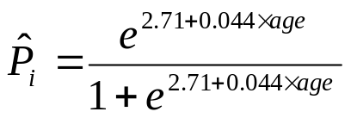
Data and predicted values
> p <- pos/N
> plot(p ~ Age, xlab = "Age", ylab = "Prevalence")
> lines(Age, fit.Sero$fit)
Predicted values:
fit.Sero$fit

Slide 58
Example 3: Bioassay
The response of the number of deaths within 7 days from injection. The dose level is the predictor.
The question of primary interest:
What is the relationship between the injected dose and the number of deaths ?
EXAMPLE 3: bioassay

Slide 59
Data structure in R
Dose of serum | Number of deaths | Sample size
0.0028 | 35 | 40
0.0056 | 21 | 40
0.0112 | 9 | 40
0.0225 | 6 | 40
0.0450 | 1 | 40
> serum <- read.table('c:/….../Serum.txt',
+ header = TRUE, na.strings = "NA", dec = ".")
> print(serum)
dose death N
1 0.0028 35 40
2 0.0056 21 40
3 0.0112 9 40
4 0.0225 6 40
5 0.0450 1 40

Slide 60
The data
> print(serum)
dose death N
1 0.0028 35 40
2 0.0056 21 40
3 0.0112 9 40
4 0.0225 6 40
5 0.0450 1 40
> plot(death/N ~ ldose,
data = serum, xlab = "Dose",
ylab = "Proportion of deaths")
EXAMPLE 3: bioassay

Slide 61

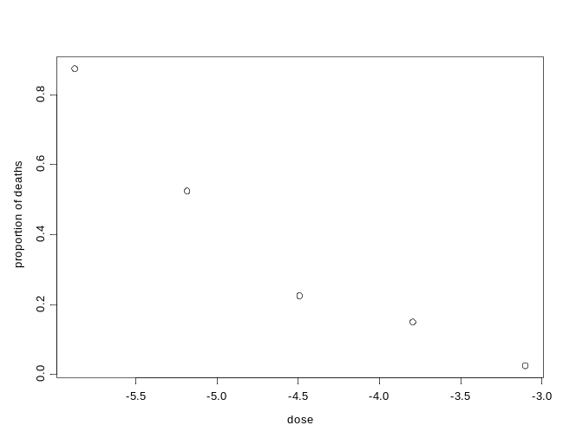
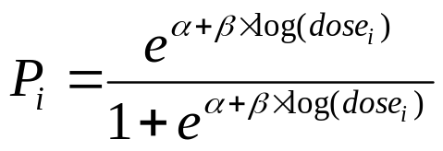
Using log(dose) as predictor
Original scale
Y: Number of deaths
The model is fitted with dose on log scale:
Log scale

Slide 62
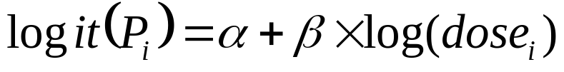
R script for the model
> fit.serum <- glm(death/N ~ ldose, data = serum,family = binomial)
Logistic regression with logit link.
Response: number of deaths.
Sample size at each dose level
print(serum)
dose death N
1 0.0028 35 40
2 0.0056 21 40
3 0.0112 9 40
4 0.0225 6 40
5 0.0450 1 40

Slide 63
Outout
> summary(fit.serum)
Call:
glm(formula = death/N ~ ldose, family = binomial, data = serum)
Deviance Residuals:
1 2 3 4 5
0.13193 -0.09818 -0.11361 0.17236 -0.02366
Coefficients:
Estimate Std. Error z value Pr(>|z|)
(Intercept) -9.189 7.938 -1.158 0.247
ldose -1.830 1.610 -1.136 0.256
(Dispersion parameter for binomial family taken to be 1)
Null deviance: 2.251289 on 4 degrees of freedom
Residual deviance: 0.070222 on 3 degrees of freedom

Slide 64
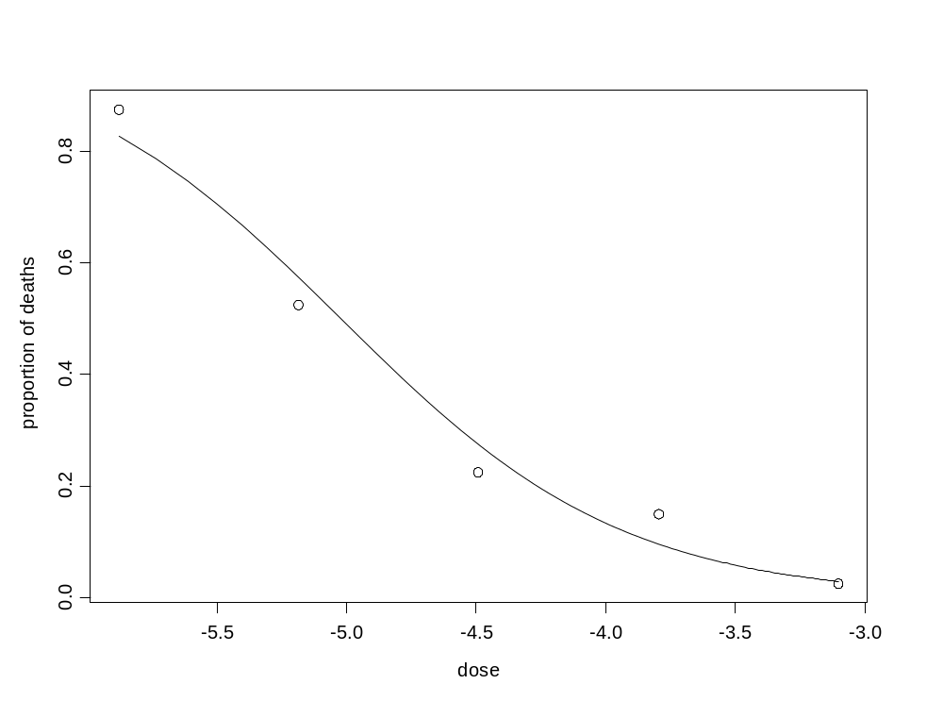
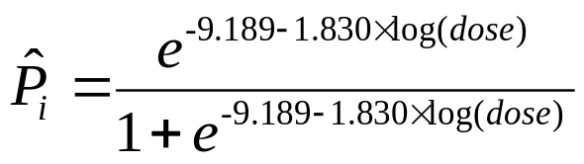
Data and fitted model
> plot(death/N ~ ldose, data = serum, xlab = "Dose",
ylab = "Proportion of deaths")
> lines(serum$ldose, fit.serum$fit)
Fitted values:

Slide 65
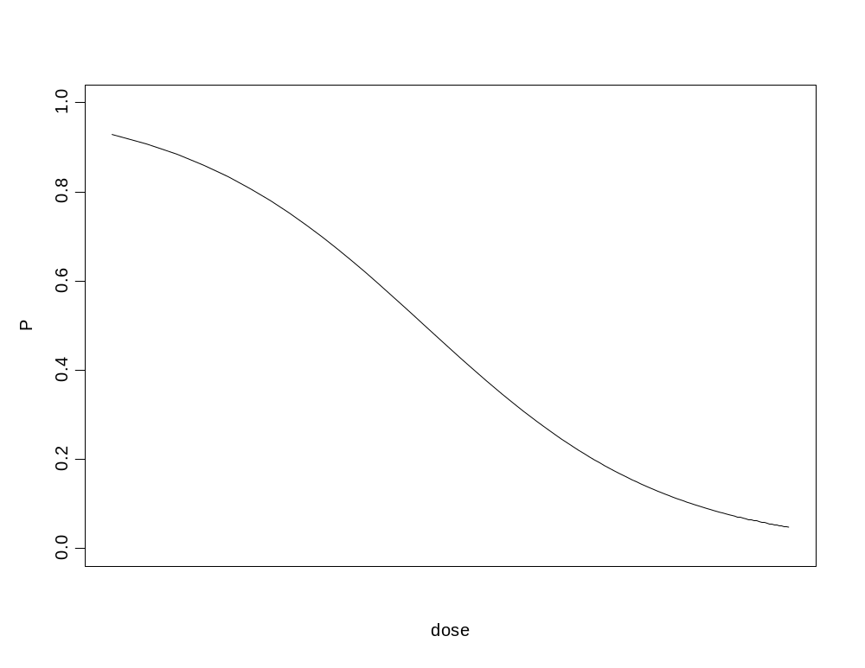

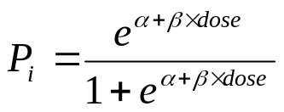
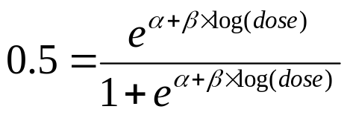
ED50
Consider the follwoing logistic regression model:
With
P=0.5
The ED50 is the dose level for which the probability for a response is equal to 0.5, this means that
ED50
This dose level is the ED50 (on log scale)

Slide 66


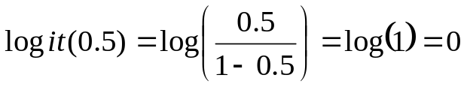
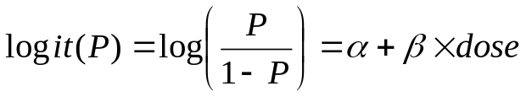
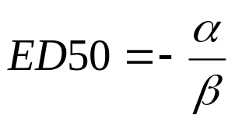

How to calculate the ED50 ?
Logit of 0.5:
Logit of P:
ED50
For P=0.5, dose=ED50, this maens that

Slide 67
Example 4: Determination of ESR
The erythocte sedimentation rate (ESR) is the rate at which red blood cells settle out of suspensin in blood plasme when measured under standard condition.
Response: binary (zero/one).

Slide 68
Data structure in R
> serum <- read.table('c:/..../Serum.txt',
+ header = TRUE, na.strings = "NA", dec = ".")
> print(serum)
dose death N
1 0.0028 35 40
2 0.0056 21 40
3 0.0112 9 40
4 0.0225 6 40
5 0.0450 1 40

Slide 69
The data: zero/one data
> plot(Y ~ Fib, data = esr, xlab = "Level of Fibrinogen",ylab = "ESR > 20")
ESR > 20
> print(esr)
Individual Fib Glob Y
1 1 2.52 38 0
2 2 2.56 31 0
3 3 2.19 33 0
.
.
13 13 5.06 37 1
14 14 3.34 32 1
15 15 2.38 37 1
16 16 3.15 36 0
17 17 3.53 46 1
18 18 2.68 34 0
19 19 2.60 38 0
ESR <= 20

Slide 70

R script for the model
> fit.esr <- glm(Y ~ Fib, data = esr, family = binomial)
Y ~ Fib
response
predictor

Slide 71
R output
Call:
glm(formula = Y ~ Fib, family = binomial, data = esr)
Deviance Residuals:
Min 1Q Median 3Q Max
-0.9298 -0.5399 -0.4382 -0.3356 2.4794
Coefficients:
Estimate Std. Error z value Pr(>|z|)
(Intercept) -6.8451 2.7703 -2.471 0.0135 *
Fib 1.8271 0.9009 2.028 0.0425 *
---
Signif. codes: 0 ‘***’ 0.001 ‘**’ 0.01 ‘*’ 0.05 ‘.’ 0.1 ‘ ’ 1
(Dispersion parameter for binomial family taken to be 1)
Null deviance: 30.885 on 31 degrees of freedom
Residual deviance: 24.840 on 30 degrees of freedom
AIC: 28.84
Number of Fisher Scoring iterations: 5

Slide 72



Data and fitted model
> plot(Y ~ Fib, data = esr, xlab = "Level of Fibrinogen",
ylab = "ESR > 20")
> lines(Fib, fit.esr$fit)
= fit.esr$fit
> summary(fit.esr)$coeff
Estimate Std. Error z value Pr(>|z|)
(Intercept) -6.845075 2.7702849 -2.470892 0.01347765
Fib 1.827081 0.9008553 2.028162 0.04254367

Slide 73
Example 5: Pneumoconiosis amongst coal miners
Pneumoconiosis amongst groups of coal miners with varying exposure to coal dust.
Does exposure time increase the probability to have the disease ?
A YouTube tutorial:
  Statistics with R: Example of logistic regression (host by Phil Chan):
  https://www.youtube.com/watch?v=xEllScuasns

Slide 74

Data structure in R
> Years<-c(5.8,15.0,21.5,27.5,33.5,39.5,46.0,51.5)
> Cases<-c(0,1,3,8,9,8,10,5)
> Miners<-c(98,54,43,48,51,38,28,11)
> CW<-cbind(Cases,Miners-Cases)
> CW
Cases
[1,] 0 98
[2,] 1 53
[3,] 3 40
[4,] 8 40
[5,] 9 42
[6,] 8 30
[7,] 10 18
[8,] 5 6
> plot(Years,Cases/Miners, xlab = "Exposure year", ylab = "Proportion of cases")

Slide 75



Variables and model formulation
> data.frame(Years,Cases,Miners)
Years Cases Miners
1 5.8 0 98
2 15.0 1 54
3 21.5 3 43
4 27.5 8 48
5 33.5 9 51
6 39.5 8 38
7 46.0 10 28
8 51.5 5 11
Pneumoconiosis
healthy
Number of infected at each exposure group
n_{i}: sample size at each exposure group
We use logistic regression to model the probability of infection a function of exposure time in years:

Slide 76
R script for the model
> fit.miners2 <- glm(CW~ Years, family = binomial)
CW ~ Years
> CW
Cases
[1,] 0 98
[2,] 1 53
[3,] 3 40
[4,] 8 40
[5,] 9 42
[6,] 8 30
[7,] 10 18
[8,] 5 6
Predictor: exposure time in years

Slide 77


R output
> summary(fit.miners2)
Call:
glm(formula = CW ~ Years, family = binomial)
Deviance Residuals:
Min 1Q Median 3Q Max
-1.6625 -0.5746 -0.2802 0.3237 1.4852
Coefficients:
Estimate Std. Error z value Pr(>|z|)
(Intercept) -4.79648 0.56859 -8.436 < 2e-16 ***
Years 0.09346 0.01543 6.059 1.37e-09 ***
---
Signif. codes: 0 ‘***’ 0.001 ‘**’ 0.01 ‘*’ 0.05 ‘.’ 0.1 ‘ ’ 1
(Dispersion parameter for binomial family taken to be 1)
Null deviance: 56.9028 on 7 degrees of freedom
Residual deviance: 6.0508 on 6 degrees of freedom
AIC: 32.877
Number of Fisher Scoring iterations: 4

Slide 78



Data and predicted model
> plot(Years,Cases/Miners, xlab = "Exposure year",
ylab = "Proportion of cases",ylim=c(0,0.6))
> lines(Years,fit.miners2$fit)
Coefficients:
Estimate Std. Error z value Pr(>|z|)
(Intercept) -4.79648 0.56859 -8.436 < 2e-16 ***
Years 0.09346 0.01543 6.059 1.37e-09 ***
fit.miners2$fit
=fit.miners2$fit

